Slide 1
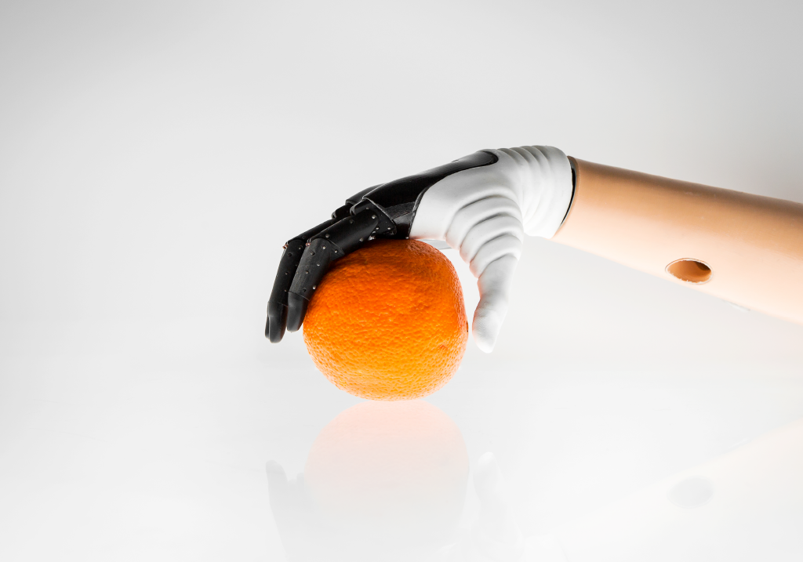
Hannes transradial hand prosthesis

Slide 2
Indice
Introduzione: Che cos’è? (in generale) Da chi è stata fatta?
Idea e obiettivi: Figura schematica riassuntiva
Struttura hardware e funzionamento: Immagini mano e meccanismi
Più slides sui punti di forza e caratteristiche particolari

Slide 3
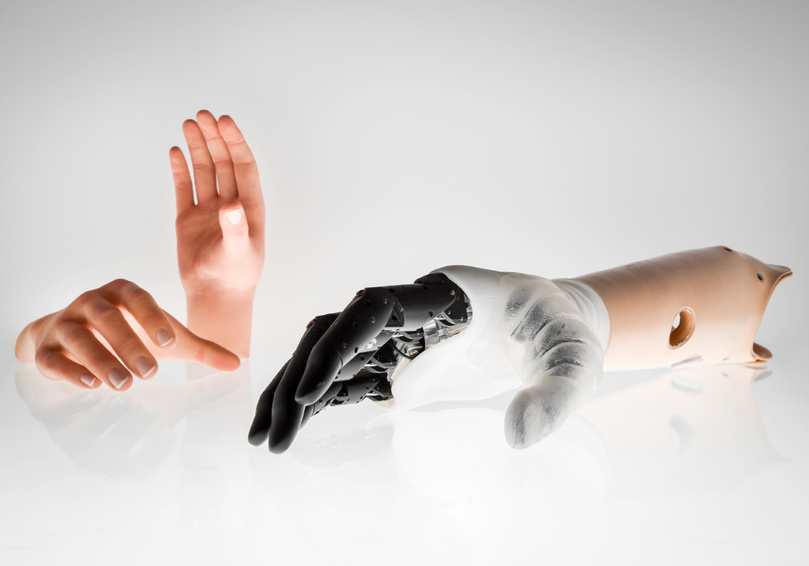
Introduction to Hannes
The Hannes prosthetic hand, developed by INAIL and the Italian Institute of Technology through Rehab Technologies, is a sophisticated under-actuated poly-articulated device known for its leader-follower wire configuration that controls finger movements.
The name "Hannes" pays homage to Professor Hannes Schmidl, a pioneer in research at the Prosthesis Center of Vigorso di Budrio and the creator of the first myoelectric prosthesis in 1965.

Slide 4
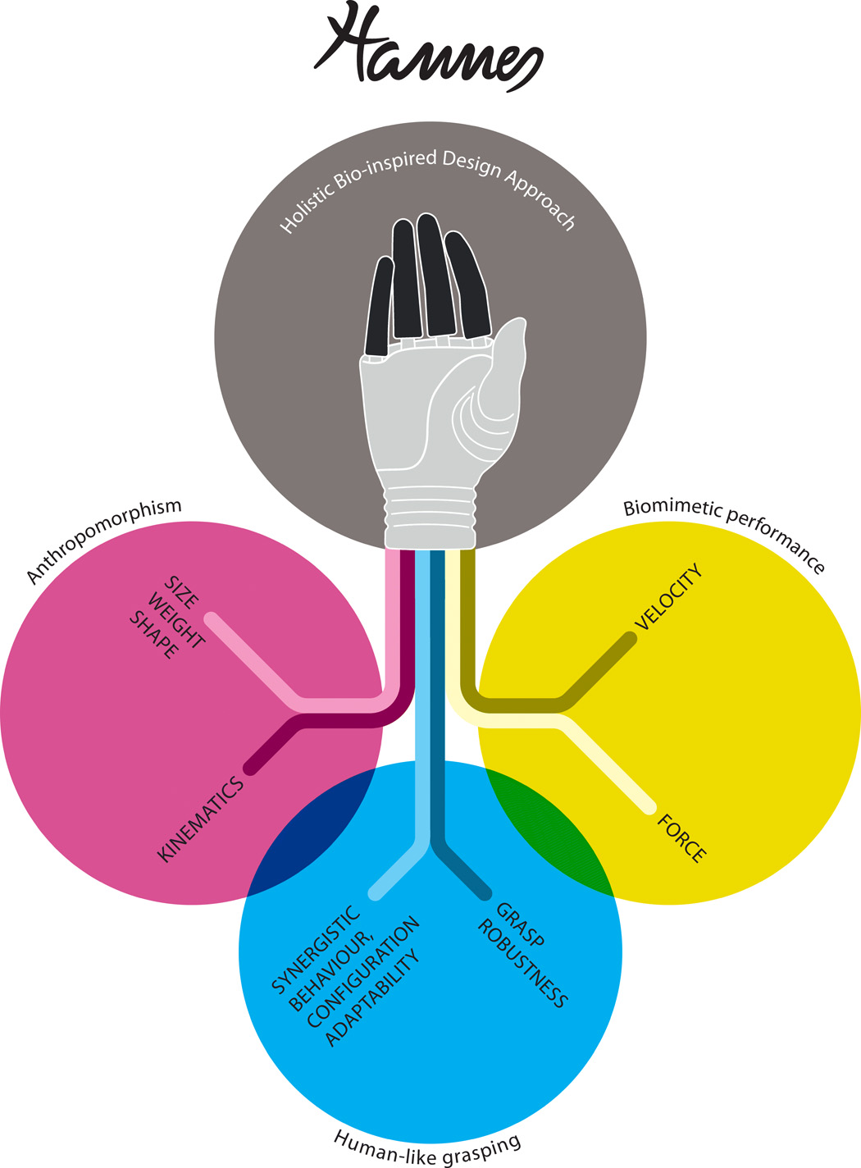
Concepts and Goals
Several studies have been carried out to determine the key factorsthat characterize the behavior and properties of the human hand as a guide to achieve a truly bioinspired prosthetic device; these factors are as follows: (i) anthropomorphic-related features, which include kinematics, size, weight, and appearance (4, 10, 11); (ii) performance such as speed, force, and dexterity (10, 12); and (iii) robust and synergistic grasping
We propose a prosthetic hand called Hannes that incorporates high levels of biomimicry through the concurrence of anthropomorphism, performance, and functionality, which lead to better performance compared with other existing research and commercial prosthetic devices. This result was achieved by organically involving researchers, patients, orthopaedists, and industrial designers in a codesign process. Last, we perform a thorough evaluation of the device through laboratory tests and clinical trials on amputated participants.

Slide 5
Concepts and Goals
The proposed of this device is
simultaneously achieves accurate:
Anthropomorphism
Biomimetic performance
Human-like grasping behavior

Slide 6
Concepts and Goals
The proposed of this device is
simultaneously achieves accurate:
Anthropomorphism
Biomimetic performance
Human-like grasping behavior

Slide 7
Concepts and Goals
The proposed of this device is
simultaneously achieves accurate:
Anthropomorphism
Biomimetic performance
Human-like grasping behavior

Slide 8
Concepts and Goals
The proposed of this device is
simultaneously achieves accurate:
Anthropomorphism
Biomimetic performance
Human-like grasping behavior

Slide 9
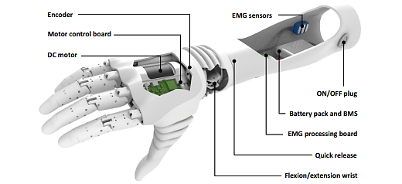
Struttura generica
Hannes comprises three primary components: a myoelectric poly-articulated prosthetic hand with a differential underactuated mechanism, a passive flexion-extension (F/E) wrist module, and a myoelectric interface/controller containing two surface electromyographic (sEMG) sensors, a battery pack, and control electronics.
These components are designed to achieve anthropomorphism, biomimetic performance, and human-like grasping, recognized as crucial factors in determining the overall effectiveness of a prosthesis.
The integrated architecture embeds the DC motor and motor control board within the myoelectric hand, while the sEMG-based controller is housed in the socket, with the F/E wrist positioned between these two modules. The holistic biomimetic design approach underlines the synthesis of these elements for enhanced functionality.

Slide 10
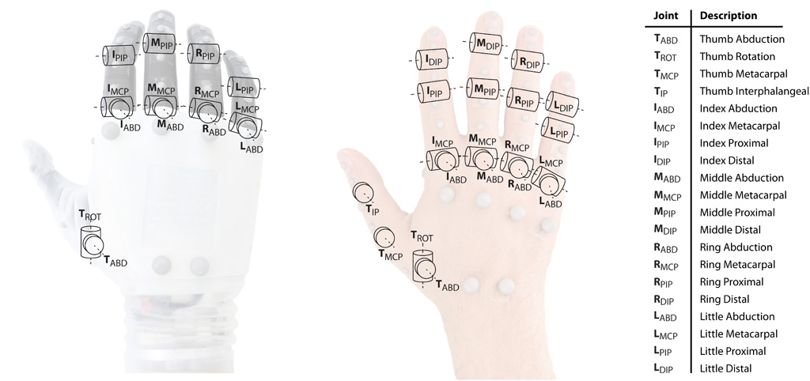
Struttura cinematica
Anthropomorphic analysis of Hannes reveals a high fidelity reproduction of dimensions and kinematics, with the exception of the design approximation for fixing the digits' distal DOFs. Notably, the DIP joint's contribution to hand functionality is minimal compared to other joints. This underscores Hannes' exceptional anthropomorphism, surpassing even state-of-the-art devices like the Michelangelo prosthesis. Lastly, Hannes weighs 480 g, closely aligning with the mass of its biological counterpart.

Slide 11
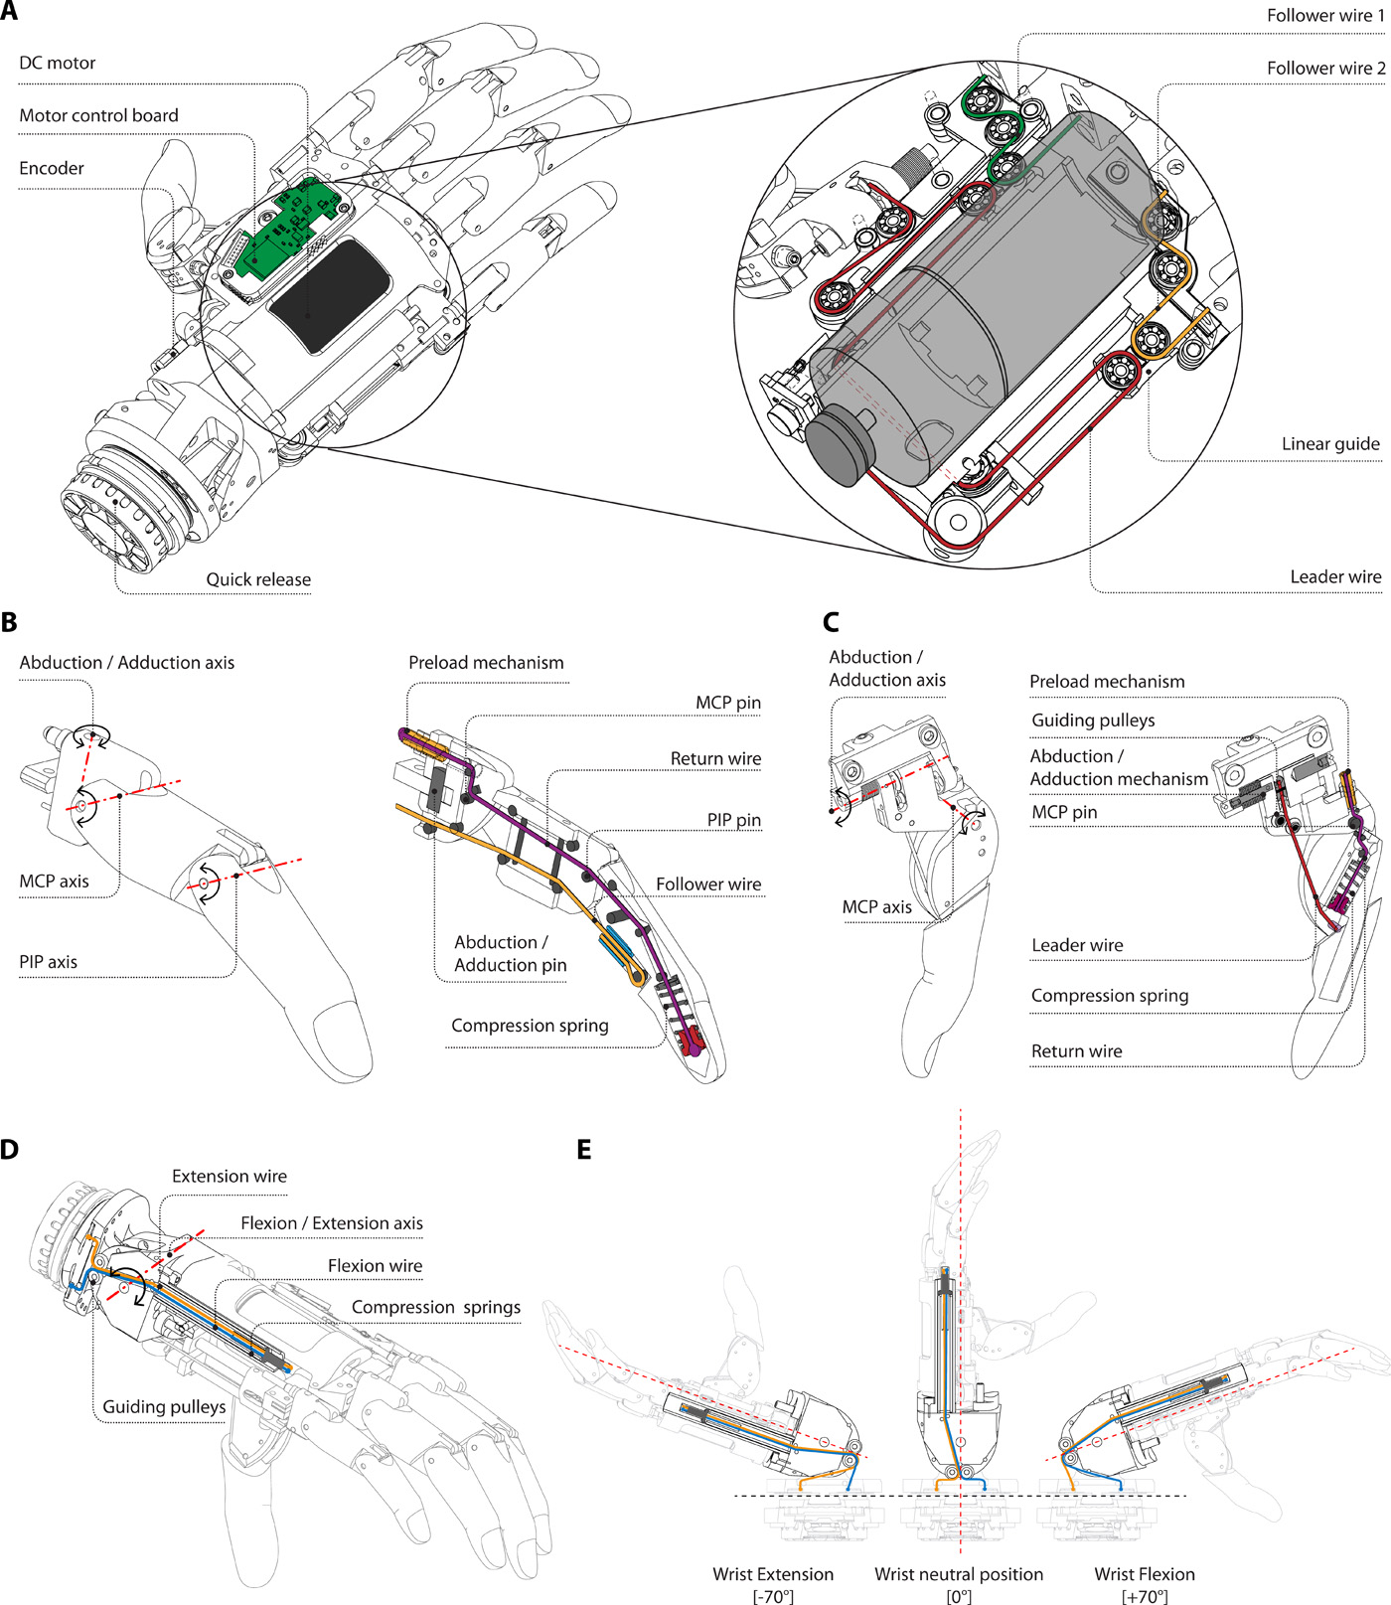
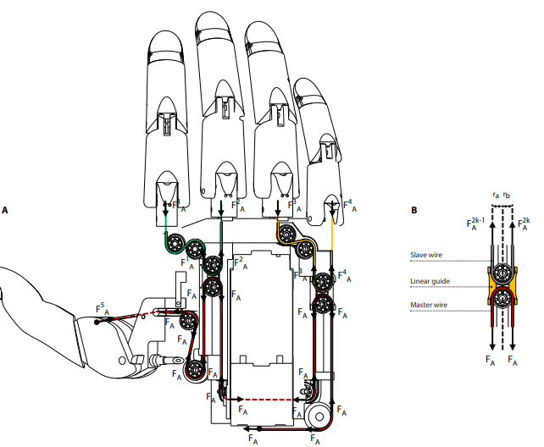
Struttura meccanica
Hannes incorporates essential components within its palm, including an electric actuator, a control board, sensors, and the transmission mechanism. The F/E extension flexible wrist is situated at the device's base. The power train features a compact, high-power-density DC motor paired with a custom-made hypocycloid gearbox.
The leader wire originates from the motor and extends to the thumb, passing through two differential elements on linear guides. These guides are comprised of custom-made bush bearings and two rails, facilitating the movement of the bushing. Two follower wires are employed: the first for the index and middle fingers, and the second for the ring and little fingers.

Slide 12
Pregi e Difetti
Note that a prosthesis weight that matches the weight of a human hand is generally described by users as being too heavy, and it is well known that the perceived weight increases due to the fact that the weight is borne by the stump’s soft tissue and not the skeletal system as in the case of healthy participants (53). Nevertheless, it is extremely challenging to replicate weight levels below the weight of a human hand because of the constraints of current electromechanical systems and material technologies. Hence, we decided to set the reference weight value to the weight of a human hand.

Slide 13
Pattern Recognition
Il controllo della mano si basa sul pattern recognition.
Attualmente nella maggior parte di mani, vengono usati due sensori, uno per il muscolo flessore e uno per il muscolo estensore.
I segnali EMG vengono processati, tramite sensori e le due principali categorie sono l’OTTOBOCK e IIT.
Tramite vari esperimenti, si è provato a migliorare il rilevamento dei segnali EMG e si è visto come il NLR sia l’algoritmo che permette di avere prestazioni ottimali utilizzando il minor numero possibile di elettrodi. In questo modo si riesce a ottimizzare la struttura fisica del dispositivo, i costi e le prestazioni.

Slide 14
State of art analysis
Il testo descrive i progressi nelle protesi del braccio superiore nel corso degli anni e il vasto mercato dei dispositivi protesici che offre opzioni estetiche e funzionali ai pazienti amputati. Sottolinea due principali sfide ingegneristiche nel sviluppo di protesi: l'integrazione dei componenti elettronici in uno spazio simile a quello della parte sostituita del arto e il raggiungimento di un controllo intuitivo. Si menziona che i dispositivi mostrati sono prodotti da Ottobock, uno dei principali attori nel mercato delle bioniche umane indossabili. Si descrivono tre tipi di protesi: una protesi passiva utilizzata per sostituire fisicamente la parte mancante, un gancio attivo in grado di afferrare oggetti con forza e rapidità, e protesi poliarticolate avanzate come il Michelangelo di Ottobock e la i-Limb Ultra di Touch Bionics (ora di proprietà di Ossür). Queste ultime offrono sia estetica che funzionalità, consentendo operazioni naturali con strumenti e tecnologie quotidiane. Viene anche menzionata la Bebionic hand di RSL Steeper, acquisita da Ottobock, che è una protesi poliarticolata con motori individuali per ciascun dito, offrendo una maggiore destrezza e la capacità di manipolare oggetti di diverse forme e dimensioni. Infine, si sottolinea che, nonostante i modelli precedenti utilizzino tecnologie simili per aprire o chiudere le dita, il loro intervallo di movimento è limitato.

Slide 15
The hand powertrain consists of a single DC motor coupled with a custom planetary gearhead, which drives the grasping movement (refer to Supplementary material). The actuation system is controlled by a position reference (ϑref) synthesized from the user’s EMG signals. A magnetic encoder measures the slow shaft position (ϑout) of the hand drive train, therefore, controlling the desired grasp configuration. The low-level control system is based on a series of proportional–integrative–derivative (PID) controllers. The outer loop is position based (where only proportional and derivative (PD) terms are deployed), while the inner loop is current based and concerns proportional and integrative (PI) terms only. In particular, the error (εpos) between ϑref (hand control command) and ϑout (outer feedback) is fed to the outer PD loop. The related output is then multiplied by a proportional gain, resulting in a current reference (iref) which is subtracted with the measured one (iout, inner secondary feedback which is the current absorbed by the DC motor during hand movement and grasp). As consequence, the related error (εi) is then fed to the inner PI controller, hence, generating the control command (V) to be delivered to the motor driver. As with many under-actuated prostheses, Hannes is undersensorized. Indeed, the only available measurements are motor-side current and position.

